Slide 1
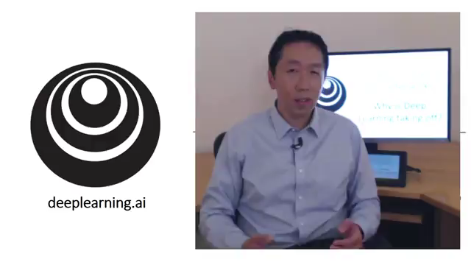
1.3 Why is Deep Learning taking off ?

Slide 2
Scale drives deep learning progress
Performance
Amount of data

Slide 3

Scale drives deep learning progress
Idea
Data
Computation
Algorithms
Experiment
Code

Slide 4
DL and Remote Engineering

Slide 5
DL and Remote Enginerring
RE -> IoT and networks
Networks : prediction and identification
DL method to solve
Applications: autonoumos driving, environmental monitoring, autonoumos self healing systems
Find your own application

